Slide 1
Web Application Development
jQuery

Slide 2
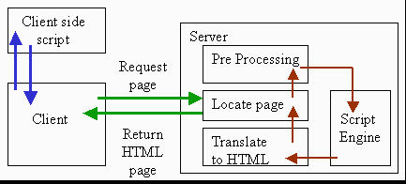
Client-Side Scripting

Slide 3
Why use client-side scripting?
Server side languages already allows us to create dynamic web pages. Why also use client-side scripting?
Client-side scripting (Javascript) benefits:
Usability: can modify a page without having to post back to the server (faster UI)
Efficiency: can make small, quick changes to page without waiting for server
Event-driven: can respond to user actions like clicks and key presses

Slide 4
Why use server-side programming?
Server-side programming (ASP.NET, PHP, etc.) benefits:
Security: has access to server's private data; client can't see source code
Compatibility: not subject to browser compatibility issues
Power: can write files, open connections to servers, connect to databases, ...

Slide 5
What is Javascript?
A lightweight scripting language which follows all the programming language fundamentals e.g. data types, control statements, loops, overloading, etc.
Used to make web pages interactive
Insert dynamic text into HTML
React to events (ex: page load, user click)
Get information about a user's computer (ex: browser type, version, etc.)
Perform calculations on user's computer (ex: form validation)

Slide 6
What Javascript can do?
Run a VM inside a browser
Run a game inside the browser
Serve 300 million users without overloading CPU
Help in making word documents, spreadsheets and PPTs online
Make real time chat possible
Atwood's Law: “Any application that can be written in JavaScript, will eventually be written in JavaScript.”

Slide 7
jQuery
jQuery is a fast and concise JavaScript Library created by John Resig in 2006 with a nice motto: Write less, do more.
The purpose of jQuery is to make it much easier to use JavaScript on your website.
jQuery simplifies HTML document traversing, event handling, animating, and Ajax interactions for rapid web development.

Slide 8
Why use jQuery when we have Javascript?
Simplicity
Browser Compatibility
Fast and Efficient
Small code length
Advance animations
SEO friendly

Slide 9
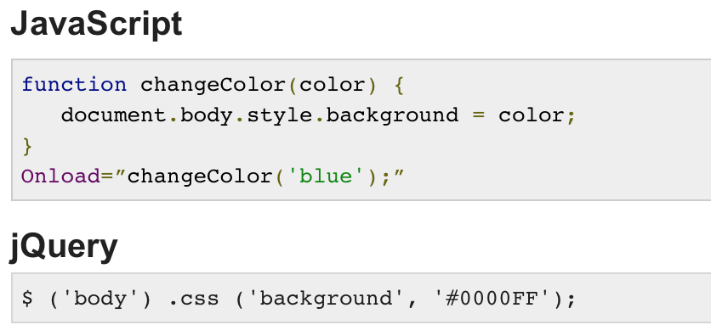
jQuery vs. Javascript Example

Slide 10
jQuery
<head> <script src="jquery-3.3.1.min.js"></script> </head>
Above lines are used to import or bring in scope the Jquery
Once Jquery is in the scope then you can use it to manipulate the HTML document.

Slide 11
jQuery
JQuery Simple Syntax
$(selector).action()
sign to define/access jQuery
A (selector) to "query (or find)" HTML elements
A jQuery action() to be performed on the element(s)

Slide 12
jQuery
Examples:
$(this).hide() - hides the current element.
$("p").hide() - hides all <p> elements.
$(".test").hide() - hides all elements with class="test".
$("#test").hide() - hides the element with id="test".

Slide 13
jQuery
It is advised to write all Jquery code inside $(document).ready(…) function. Example
$(document).ready(function(){
// jQuery methods go here...
});

Slide 14
jQuery
$(document).ready(function(){
$("p").hide()
$(".test").hide()
});
This is to prevent any jQuery code from running before the document is finished loading (is ready).
It is good practice to wait for the document to be fully loaded and ready before working with it. This also allows you to have your JavaScript code before the body of your document, in the head section.

Slide 15
jQuery
jQuery Selectors
jQuery selectors allow you to select and manipulate HTML element(s).
jQuery selectors are used to "find" (or select) HTML elements based on their name, id, classes, types, attributes, values of attributes and much more. It's based on the existing CSS Selectors, and in addition, it has some own custom selectors.

Slide 16
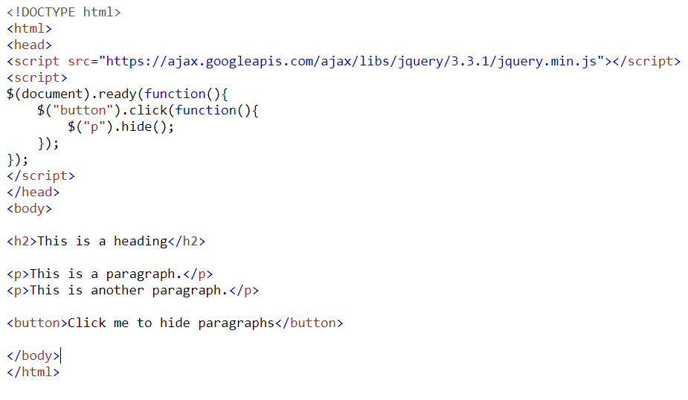
jQuery

Slide 17
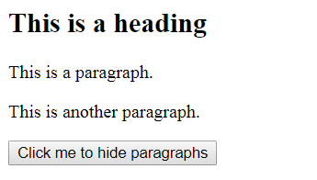
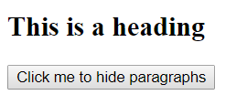
jQuery
Output
Once page loaded
Once button clicked

Slide 18
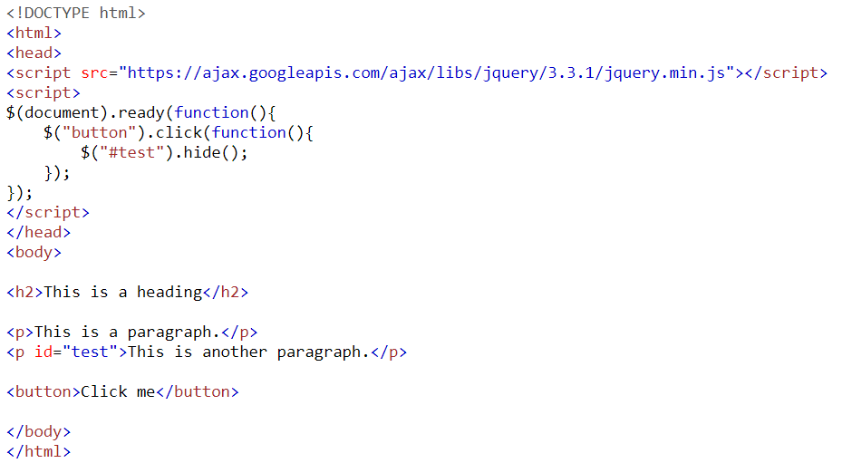
jQuery

Slide 19
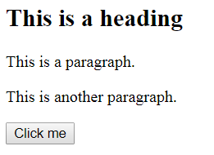
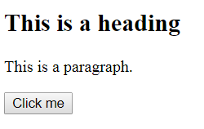
jQuery
Output
On page load
On button click

Slide 20
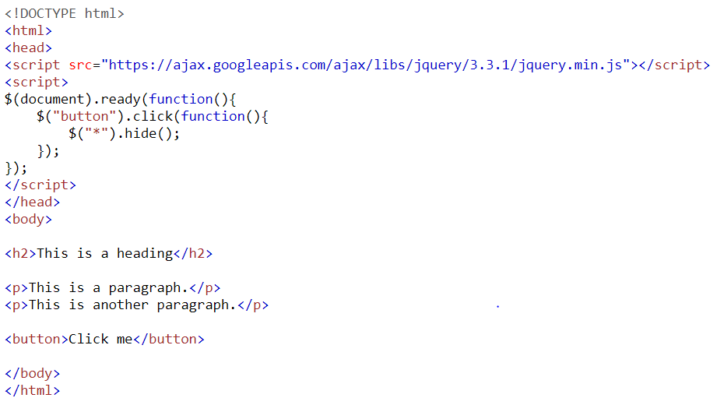
jQuery

Slide 21
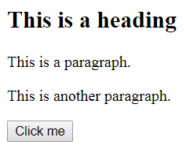

jQuery
Output
On load
On click

Slide 22
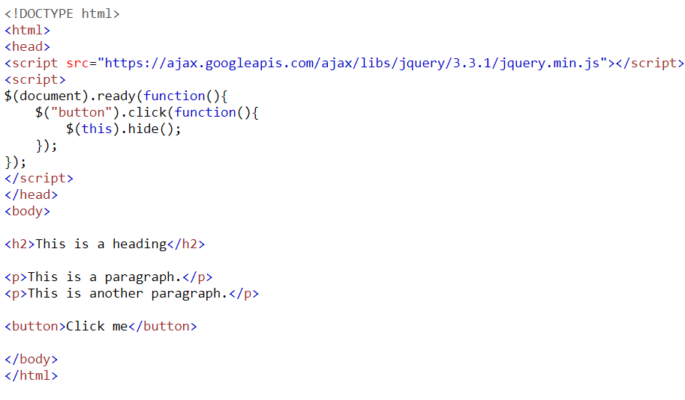
jQuery

Slide 23
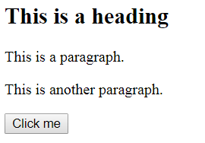
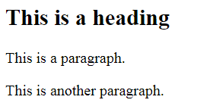
jQuery
Output
On Load
On click

Slide 24
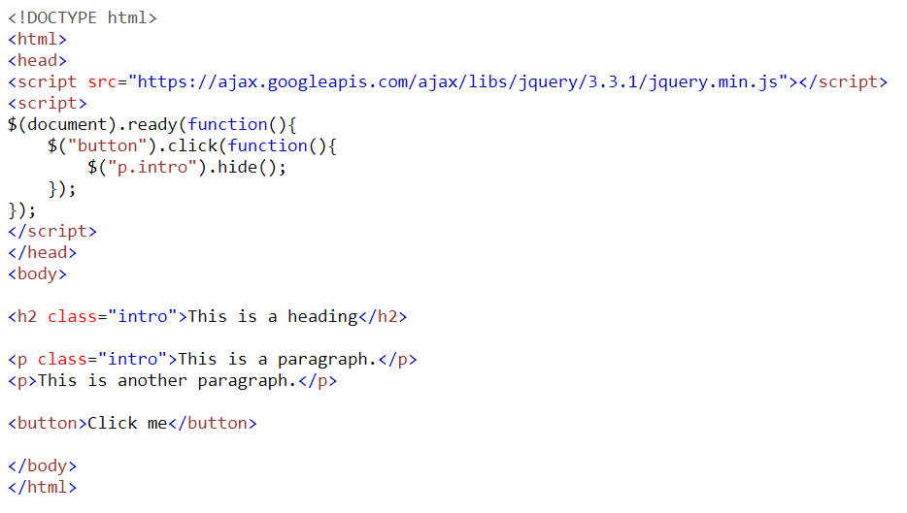
jQuery

Slide 25
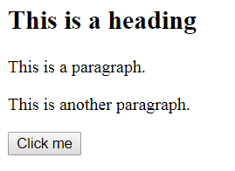
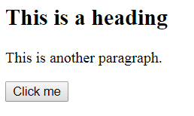
jQuery
Output
On Load
On click

Slide 26
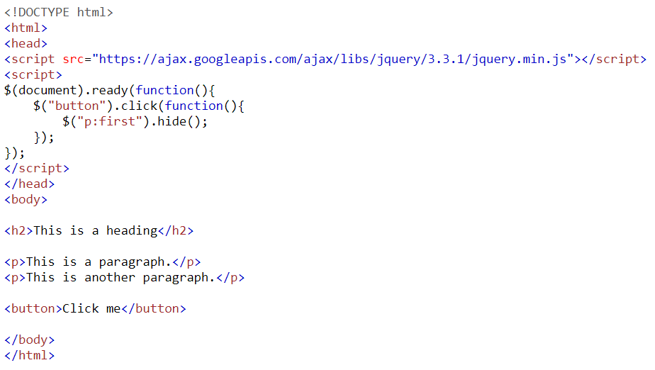
jQuery

Slide 27
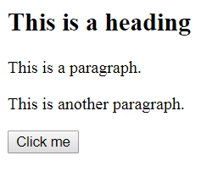
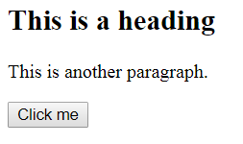
jQuery
Output
On Load
On click

Slide 28
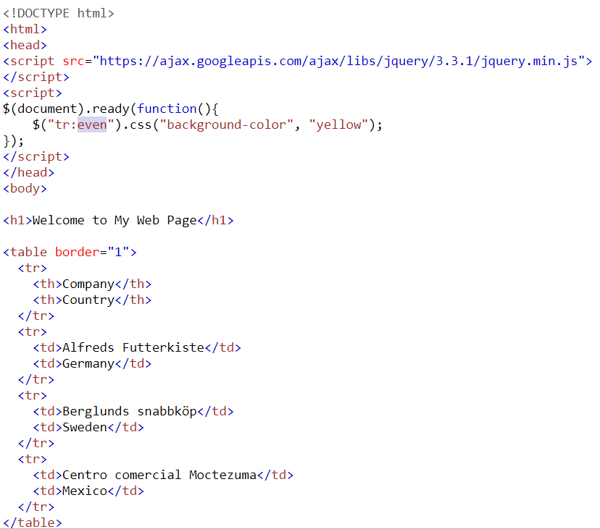
jQuery

Slide 29
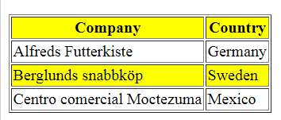
jQuery
Output
On Load

Slide 30
jQuery
JQuery Events
An event represents the precise moment when something happens.
Examples:
moving a mouse over an element
selecting a radio button
clicking on an element

Slide 31
jQuery
JQuery Events
Example of some common events
Mouse Events | Keyboard Events | Form Events | Document/Window Events
click | keypress | submit | load
dblclick | keydown | change | resize
mouseenter | keyup | focus | scroll
mouseleave |  | blur | unload

Slide 32
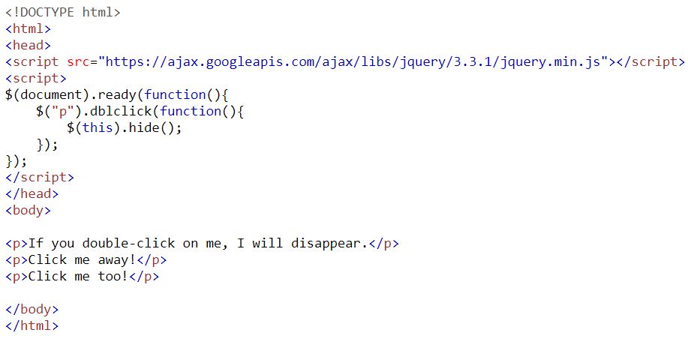
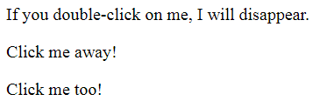

jQuery

Slide 33
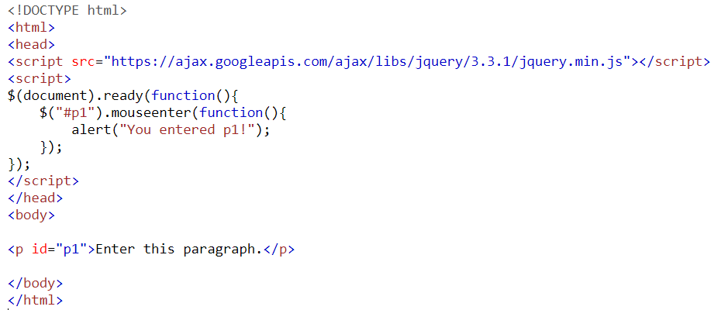

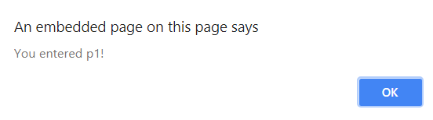
jQuery
Mouse enter event
Message appears on mouse entering p1 area

Slide 34
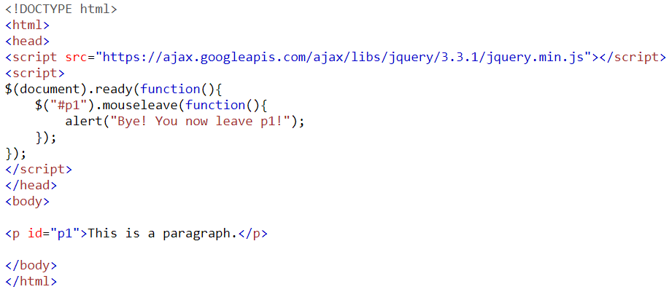
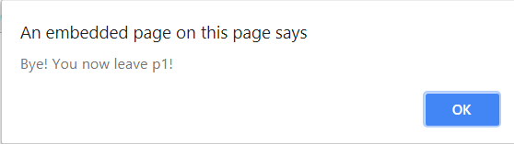
jQuery
Message appears on mouse leaving p1 area

Slide 35
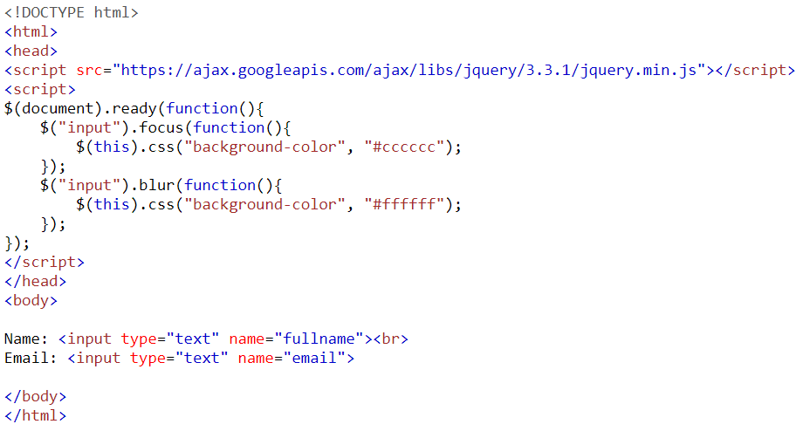

jQuery
On focus

Slide 36
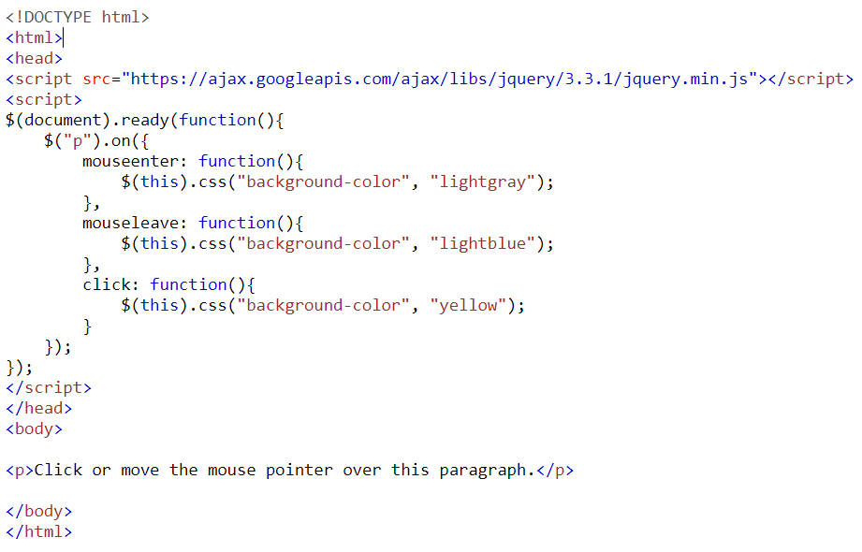
jQuery
On event

Slide 37
jQuery
Output

Slide 38
jQuery
jQuery DOM Manipulation
DOM stands for document object model e.g. the html document.
jQuery provides various methods to add, edit or delete DOM element(s) in the HTML page.
jQuery has ability to manipulate the html document such as adding any new portion to the html document e.g. adding a <p> …</p> tag to the html document at run time.

Slide 39
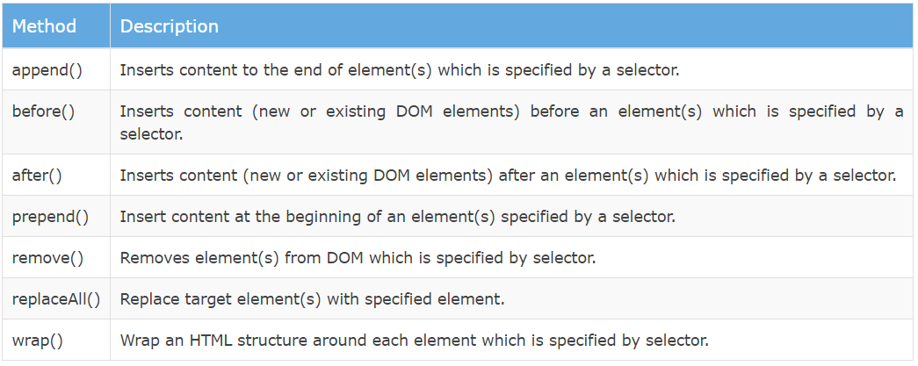
jQuery
DOM Manipulation Methods in jQuery
The following table lists some important methods to add/remove new DOM elements.

Slide 40
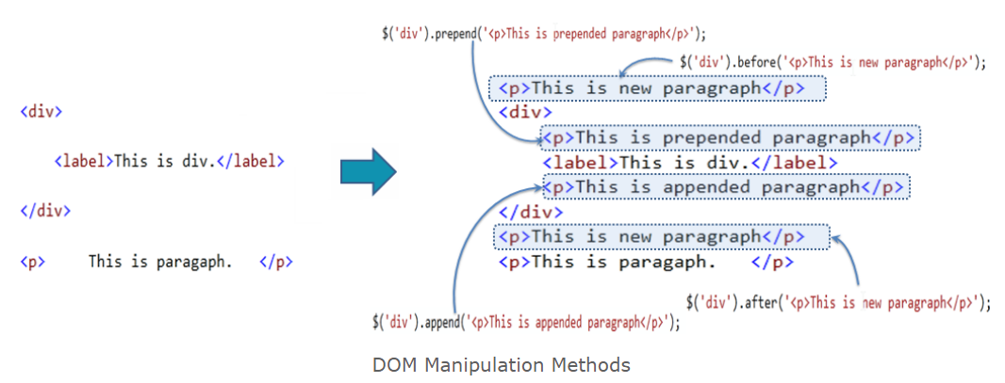
jQuery
The following figure shows how the DOM manipulation methods add new elements.

Slide 41
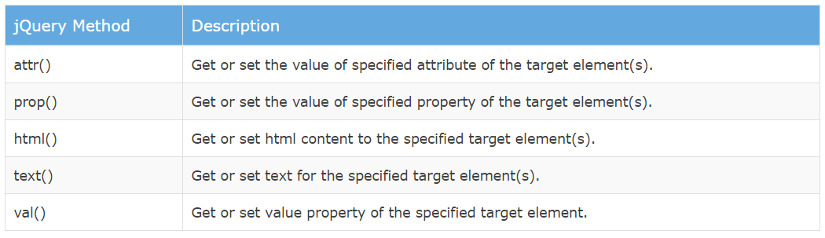
jQuery
Manipulate HTML Attributes using jQuery
The following table lists jQuery methods to get or set value of attribute, property, text or html.

Slide 42
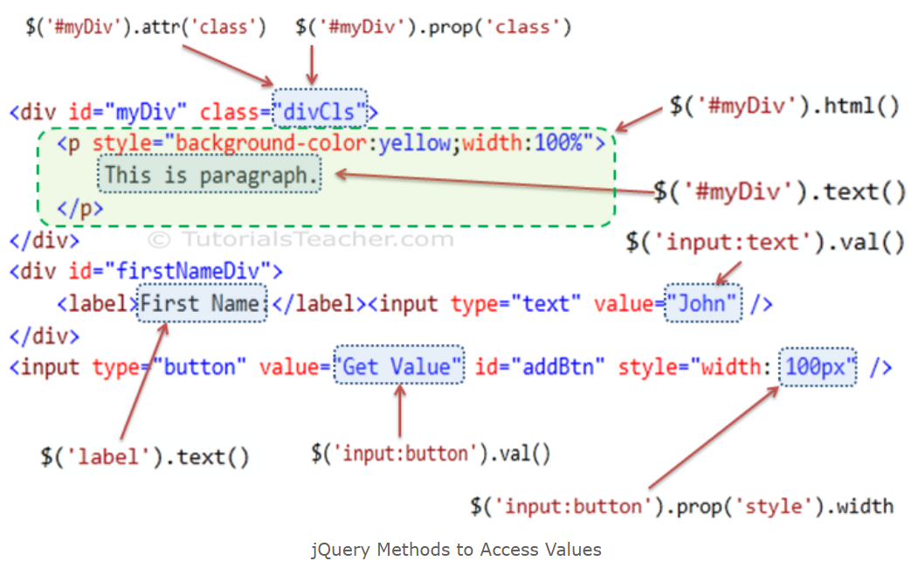
jQuery
The following figure shows various jQuery methods to access DOM element's attributes, properties and values.

Slide 43
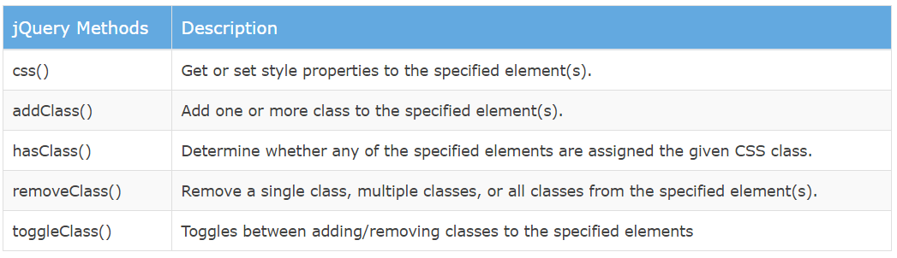
jQuery
CSS Manipulation using jQuery
The jQuery library includes various methods to manipulate style properties and CSS class of DOM element(s).

Slide 44
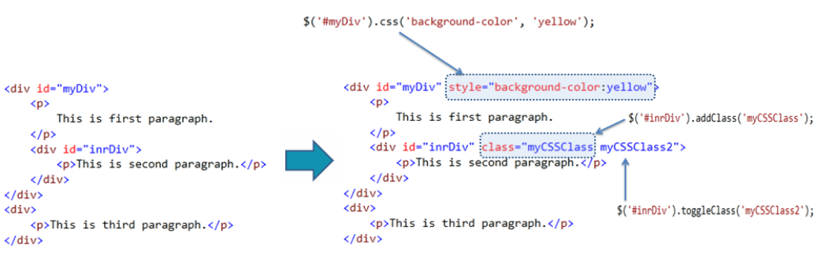
jQuery
The following figure shows how jQuery methods changes style and css class of the DOM elements.

Slide 45
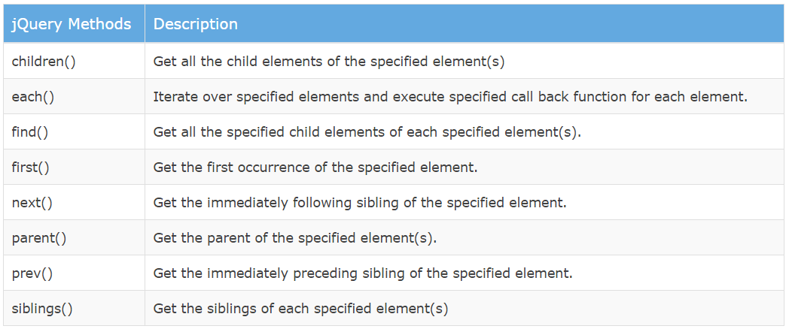
jQuery
Traversing DOM Elements using jQuery
The jQuery library includes various methods to traverse DOM elements in a DOM hierarchy.

Slide 46
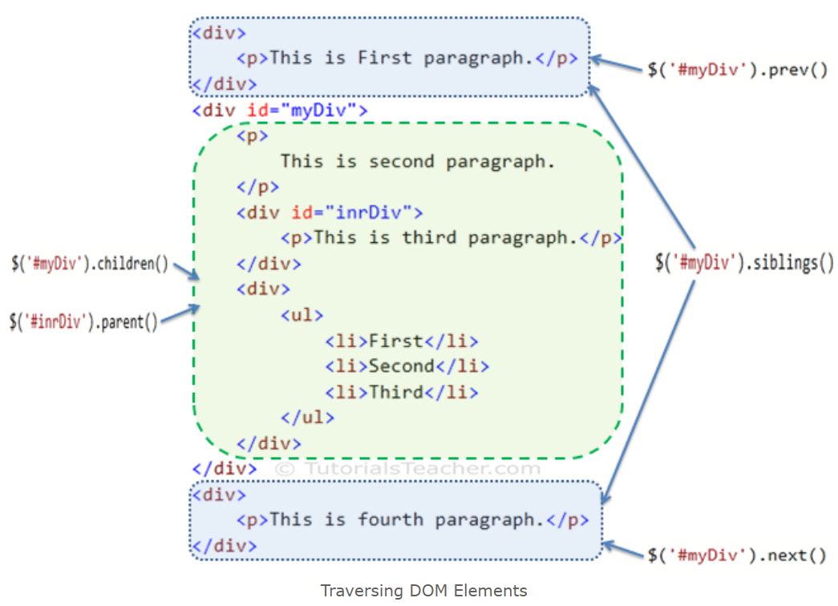
jQuery
The following figure shows how the jQuery traversing methods get DOM elements.

Slide 47



ICON
What is Icon?
An icon is a small graphical representation that helps a user to easily understand the concept or thing in a web page.
For example
Home
Time
Store/copy
Shopping cart

Slide 48
Icons
In order to use icon un your web page, you need to download icon file that contains icons.
For reference
https://kit.fontawesome.com/a076d05399.js
https://github.com/google/material-design-icons/

Slide 49
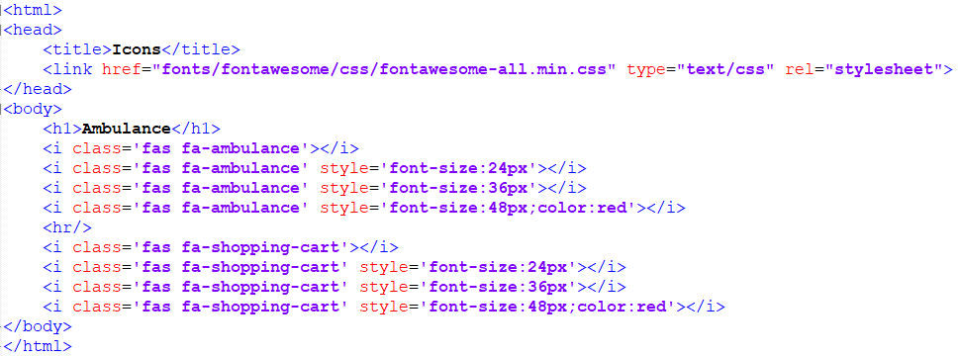
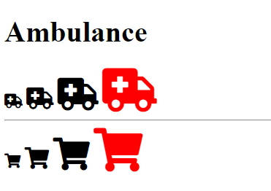
Icons: Example

Slide 50
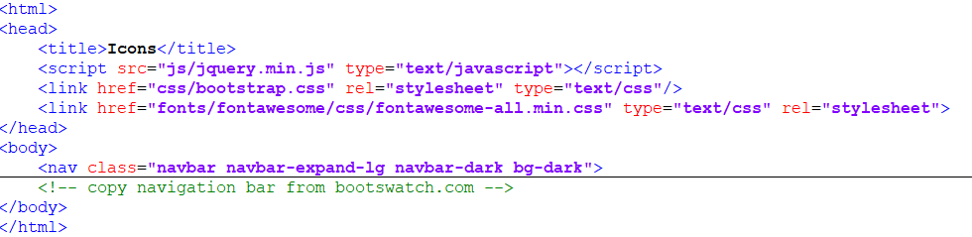
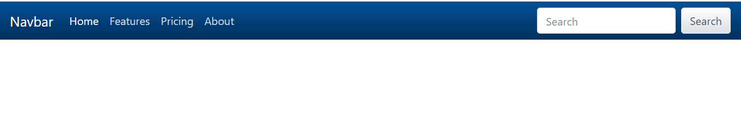
Example
Suppose you have a navigation bar and you just want to add a shopping cart icon into it.
output
Focus on : “Feature” “Pricing” “About” in next slide

Slide 51
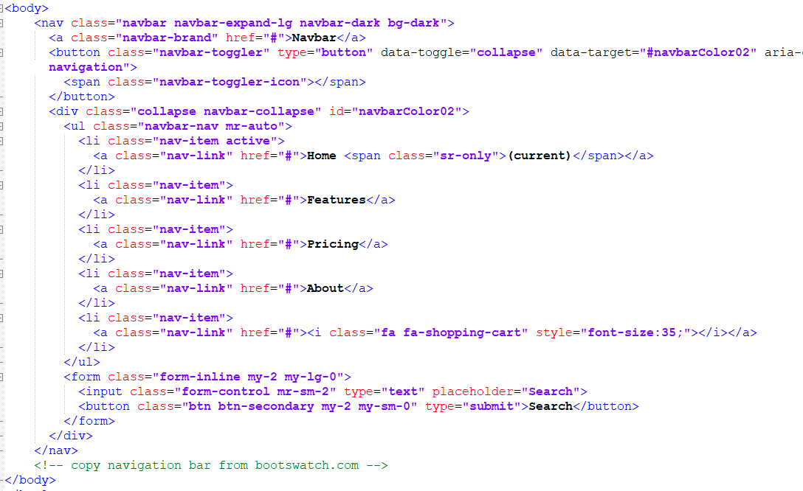
Readymade old code
Write your code

Slide 52
Icon
Output
Compare with previous one

Slide 53
Affix Property
The Affix plugin allows an element to become affixed (locked) to an area on the page. This is often used with navigation menus or social icon buttons, to make them "stick" at a specific area while scrolling up and down the page.
Affix property comes in multiple variations such as
Class=“fixed-top”
data-spy=“affic”

Slide 54
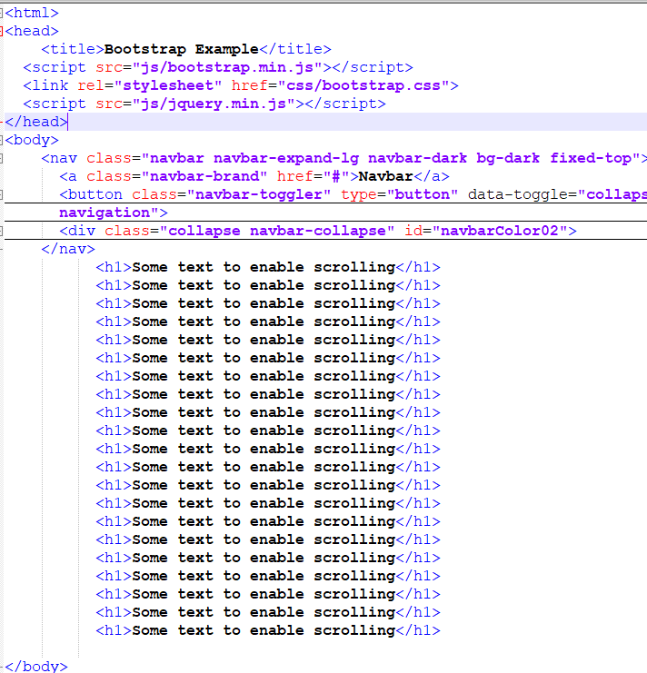
Get bootstrap.js &jquery.js from google

Slide 55
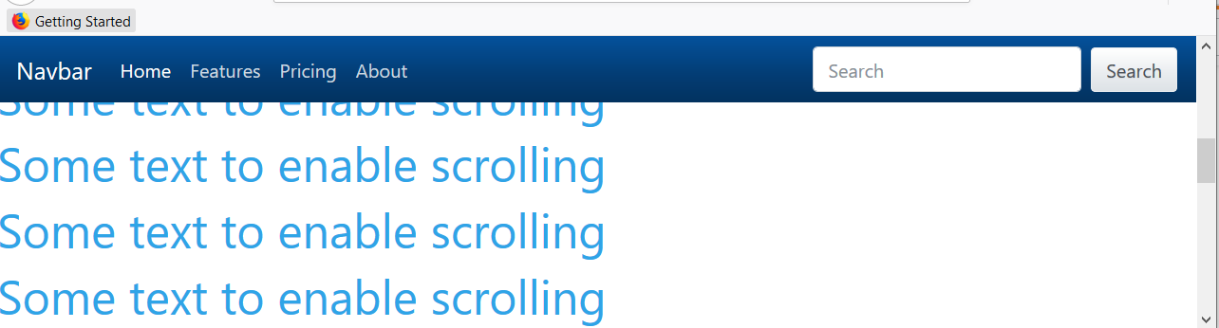
You are scrolling the page but, nav-bar is still visible!!!!!!!!

Slide 56
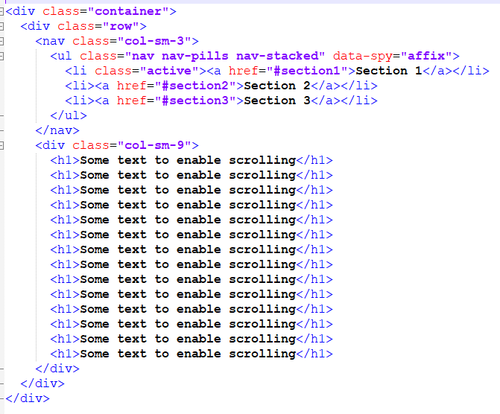
Affix Property
Example

Slide 57
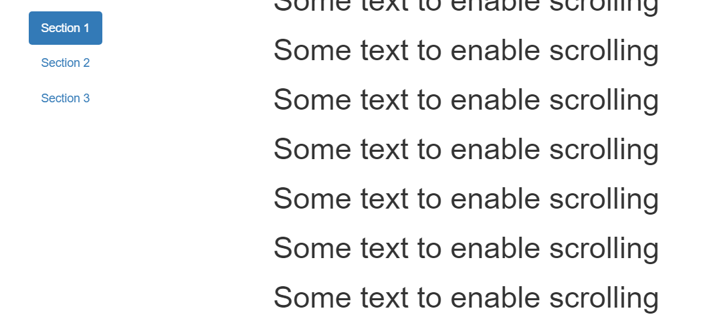
Affix Property
Output

Slide 58
Filter Element
Filter element in HTML document can help to filter required elements and hide all other elements from the document. For example
See next slide

Slide 59
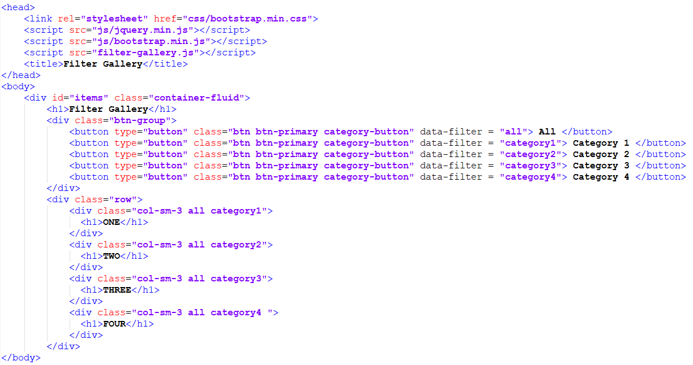
If you clicked here, then all elements with class “.all” will be visible

Slide 60
If you clicked here, then all elements with class “.category1” will be visible

Slide 61
What is inside this js file???

Slide 62
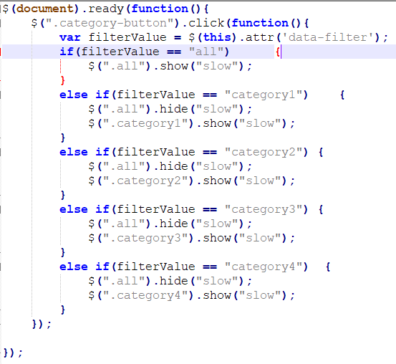
If you clicked on all, then ‘data-filter’ will contain “all” and elements with class “all” will be visible

Slide 63
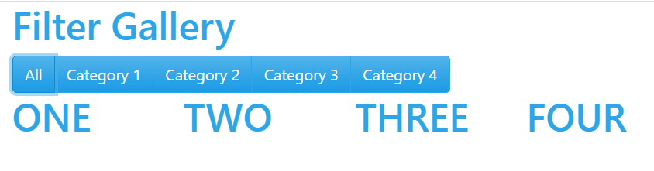
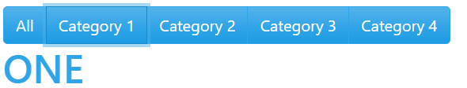

Output after click on different tabs

Slide 64

More Practical

Slide 65
Modal Dialog
The Modal plugin is a dialog box/popup window that is displayed on top of the current page.
A Modal is a dialog box/popup window that can be used for lightboxes, user notifications and UI enhancements etc.

Slide 66

Modal Dialog
If you clicked on button, the model dialog will open and it will also fade (turned dark) background

Slide 67


Modal Dialog
Now click

Slide 68



Jquery Toggle Example
The toggle() method toggles between hide() and show() for the selected elements.
This method checks the selected elements for visibility. show() is run if an element is hidden. hide() is run if an element is visible - This creates a toggle effect.

Slide 69

Dynamic Fields Creation
Jquery can create dynamic fields at runtime as described in following

Slide 70

Dynamic Fields Creation

Slide 71


Dynamic Fields Creation
Once application is loaded
Once you clicked on add button, the code inside “.copy” class is assigned to a variable named html
Then this code is made a sibling of “.original” class

Slide 72

Accordion
Accordions (Dynamic List) are useful when you want to toggle between hiding and showing large amount of content

Slide 73



Slide 74

Draggable
Draggable
Allow elements to be moved using the mouse.

Slide 75


Draggable
Interactive draggable dialogue box

Slide 76



Slide 77
Reference
https://jqueryui.com/

Slide 78
JQuery animation
jQuery includes methods which give special effects to the elements on hiding, showing, changing style properties, and fade-in or fade-out operation. These special effect methods can be useful in building an interactive user interface.
jQuery Methods for Special Effects | Description
animate() | Perform custom animation using element's style properties.
queue() | Show or manipulate the queue of functions to be executed on the specified element.
stop() | Stop currently running animations on the specified element(s).
fadeIn() | Display specified element(s) by fading them to opaque.
fadeOut() | Hides specified element(s) by fading them to transparent.
fadeTo() | Adjust the opacity of the specified element(s)
fadeToggle() | Display or hide the specified element(s) by animating their opacity.

Slide 79


JQuery animation

Slide 80

JQuery animation
Following Jquery animation brings movement affect in the previous code

Slide 81
Set Animation Duration
You can apply animation duration in miliseconds as a second parameter of animate() method.

Slide 82

Set Callback Function
Callback functions displays message once an animation completes.

Slide 83
Specify Animation Options
You can specify various options as JSON object. The options include duration, easing, queue, step, progress, complete, start, done and always.

Slide 84
jQuery queue
jQuery queue() Method
The jQuery queue() method shows or manipulates the queue of special effect functions to be executed on the specified element.

Slide 85


Slide 86
AJAX
What is AJAX
Stands for Asynchronous JavaScript and XML
Ajax isn’t a technology, instead, it is umbrella of technologies includes:
Standards-based presentation using XHTML and CSS
Dynamic display and interaction using the Document Object Model
Asynchronous data retrieval using XMLHttpRequest and Javascript

Slide 87
AJAX
Ajax is not a programming language or a tool, but a concept. Ajax is a client-side script that communicates to and from a server/database without the need for a postback or a complete page refresh.
Ajax provides the method of exchanging data with a server, and updating parts of a web page – without reloading the entire page

Slide 88
JQuery Ajax
jQuery provides several methods for AJAX functionality.
With the jQuery AJAX methods, you can request text, HTML, XML, or JSON from a remote server using both HTTP Get and HTTP Post - And you can load the external data directly into the selected HTML elements of your web page!

Slide 89
JQuery Load Method
The jQuery load() method is a simple, but powerful AJAX method.
The load() method loads data from a server and puts the returned data into the selected element.

Slide 90
JQuery Load() Method Syntax
Syntax:
$(selector).load(URL,data,callback);
The required URL parameter specifies the URL you wish to load.
The optional data parameter specifies a set of querystring key/value pairs to send along with the request.
The optional callback parameter is the name of a function to be executed after the load() method is completed.

Slide 91
Callback() function
The optional callback parameter specifies a callback function to run when the load() method is completed. The callback function can have different parameters:
responseTxt - contains the resulting content if the call succeeds
statusTxt - contains the status of the call
xhr - contains the XMLHttpRequest object

